Slide 1
INVESTIGATION PROTOCOLS IN PITUITARY ADENOMAS- FUNCTIONAL AND NON FUNCTIONAL

Slide 2
Introduction
Pituitary gland
– Pituitary fossa
• Mass: 5 gms
• DIMENSIONS
– 7mm (Ht)
– 9mm (AP)
– 11m(transverse)
originates from Rathke’s pouch and infundibulum

Slide 3
Cell type | hormone | Clinical syndrome | Tumor type
Somatotroph | Growth Hormone | Acromeg/gigan | Sparsely granulated GH cell
 |  |  | Densely granulated GH cell
Lactotroph | Prolactin | Amen/galactor | Sparsely granulated prl
 |  |  | Densely granulated prl
Somato/Lact | Gh+prl | Acro+hyperprl | Mixed GH-prl
 |  | Acro+hyperprl | Mammo+somato
 |  | Amen/Gal/Acro | Acido+stem cell
Corticotroph | Acth/Pomc/B-lph/Msh | Cushings, nelson | Densely granulated acth
 |  |  | Sparsely granulated acth
Gonadotroph | FSH,LH,A- Sub Unit | Hypopituitarism | Gonadotroph
Thyrotroph | TSH, A-sub Unit | Hyperthyroid/ Hypopituitarism | Thyrotroph
NULL Cell | None | Hypopituitarism | Null cell
 |  |  | oncocytoma

Slide 4
Introduction
15% of intracranial tumors
Present as incidental finding in 5-20%
Broadly divided
(a) functional
(b) non functional

Slide 5
INVESTIGATION PROTOCOL
History and physical examination
Neuro- ophthalmology:
Acuity, field, fundus and movements
Hormone levels Basal hormone and dynamic testing
Aim- hypersecretory state or insufficiency
Radiology (a) X-Rays
(b) MRI
(c) NCCT/CECT
Routine blood investigation

Slide 6
Presentation
Mass effect
Hyper secretion/ hypo secretion
Incidental finding
Apoplexy

Slide 7
Complete history and physical examination
Eyes – visual acuity, visual field, fundoscopy
Neck- thyroid ,carotid bruit
Chest-gynaecomastia, galactorrhea
Abdomen-striae, obesity
Extremities-edema, enlargement
Skin-pigment, hair, bruises

Slide 8
MASS EFFECT
Visual disturbances
– Visual field defect usually very insidious and slowly progressive
– Diplopia
– Visual acuity
Hydrocephalus
Headache
Cranial nerve palsies
Raised intracranial pressure

Slide 9
Apoplexy
Acute presentation secondary to tumour
haemorrhagic necrosis
– Headache
– Vomiting
– Blindness
– Ocular paresis
– Altered level of consciousness

Slide 10
Prolactin
Galactorrhoea , amennorrhoea, osteoporosis
G.H
Acromegaly, organomegaly, D.M,
ACTH
Cushing’s disease, Diabetes mellitus, osteoporosis, obesity, hypertension
TSH
Hyperthyroidism, cardiac dysrhythmia, heat intolerance

Slide 11
Radiology
X- Rays:
Widening of sella
Destruction of sellar floor
Relation of median sphenoidal septum
Aeration of sphenoid sinus- conchal
sclerotic
mixed

Slide 12
NCCT+ CECT head/ sella with thin coronal cuts:
findings as seen in X-Rays
iso dense to adjacent brain parenchyma
intense contrast enhancement
calcifications uncommon (< 5%)
apoplexy- hyper density

Slide 13
MRI brain:
Sagittal T!WI and coronal T1WI sellar and parasellar region with/without contrast 2.5mm thin contiguous slices and 5mm slices axial T2WI of whole brain.
Normal pituitary is iso intense to gray matter on T1WI with contrast enhancing
Pituitary adenoma classified based on size:
microadenoma <10mm
macroadenoma >10mm
giant pit adenoma >40mm

Slide 14
Macro adenoma – they are hypo to isointense to gray matter on T1WI, contrast enhancing
Micro adenomas- Dynamic contrast study done by 5 T1WI turbo spin 3mm thin slices repetitively at 20,40,60,80,100 sec after 10ml contrast injection at 2ml/sec.
Micro adenoma enhance and wash out quickly as
compared to normal gland post contrast and hence appear
hypointense
deviation of stalk
bulging of inferior and superior margin

Slide 15
Normal Gland
Signal Intensity
Adenoma
t₀
Time
t_{x}

Slide 16
Hardy classification
Pituitary adenoma:
Grade 0- size < 10 mm, sella normal
Grade 1- size < 10 mm, sella expanded
Grade 2- size > 10 mm , sella expanded
Grade 3- size > 10 mm, focal Destruction
Grade 4- size > 10 mm, diffuse destruction
Grade 5- distant spread

Slide 17
Based on extension
Suprasellar
0- none
A- supra sellar cistern
B- ant recess of third ventricle obliterated
C- floor of third ventricle grossly displaced
Parasellar
D- intracranial (intradural)
E- into or beneath the cavernous sinus

Slide 18
Screening studies for pituitary lesion
Hormone excess
serum prolactin
serum IGF-1
serum LH, FSH
serum A sub unit
serum TSH
urinary24 hr cortisol
Hormone deficiency
serum cortisol
serum T4, free T3
serum testosterone (men)
serum estradiol (women)

Slide 19
Dynamic test to identify pituitary hypersecretion
Dynamic stimulation/suppression testing may be useful in select cases to further evaluate pituitary reserve and/or for pituitary hyperfunction
Acromegaly
Oral glucose test-
Cushings syndrome/disease- (a)low dose dexamethasone
(b)low dose dexamethasone +CRH
(c)high dose dexamethasone
(d)Inferior petrous sampling + CRH

Slide 20
Dynamic test to identify pituitary deficiency
ACTH – low dose ACTH by giving 1 mcg iv and S. cortisol after 30 min less than 18 mcg/dl identifies central adrenal deficiency

Slide 21
Prolactinoma
30 to 50% of endocrine active tumors
Clinical features:
Amennorhoea infertility, loss of libido, oligospermia
Galactorrhoea in 80% females and 30% men
Majority are microadenomas
30% of them in women are self limiting

Slide 22
Prolactinoma
Prolactin
< 25 ng/ ml normal
25- 150ng/ml prolactinoma, stalk effect, drugs , Hypothyroid
> 150ng/ml- prolactinoma
Hook effect- even large elevations will show normal PRL levels on testing due to large size of molecules. Do serial dilutions

Slide 23
Not all hyperprolactinemia is due to a prolactinoma

Slide 24
Causes of Hyperprolactinemia
Medications
Psychotropic (e.g.. haloperidol. resperidol)
Antidepressants (e.g.. amoxapin)
Estrogen
Opiates
Calcium channel blocker (veraparnil)
Antihypertensives (a methyldopa. reserpine)
Dopamine antagonists (domperidome. metoclopramide) Pituitary Pituitary adenoma
Prolactin-secreting adenoma
GH-secreting adenoma
Secondary hyperprolactinemia. usually a macroadenoma
Other pituitary lesion. e.g.. inetastatic. sarcoid. aneurysm
Hypothalamic lesion
Head trauma
Pregnancy
Spinal cord lesions
Chest wall trauma
Nipple stimulation

Slide 25
Cushings disease
15% of all pituitary adenomas in adults
90% microadenomas
Common in women
55 % pit adenoma in children
Clinical features:
  Central obesity, purple striae, hypertension, diabetes, ecchymosis, poor wound healing, lipid abnormalities, neuropsyhiatric problems

Slide 26
Cushings disease
Best screening test- 24 hr UFC level 95-100% sensitivity, 400 mcg/day of UFC is diagnostic.
midnight plasma cortisol of 5.2mcg/dl is diagnostic of cushings
Low dose dexamethasone test- 1 mg of dexa at 11.00 am and measurement of s. cortisol at 8.00 am
<5 mcg/dl- normal
5-10 mcg/dl equivocal
>10mcg diagnostic
Plasma corticotropin level- >20pg/ml diagnostic
>10 pg/ml suggestive
<5pg/ml corticotroph
independent

Slide 27
Cushings disease
High dose dexa suppression test- if corticotrops >10 pg/ml . 2mg of dexa given every 6hrly for 2 days, if > 69% fall in 24 hr UFC (pre and post dexa ) is 100% specific for CD
8 mg dexamethasone test -8 mg dexamethasone is given at 11.00 pm and drop in >50% s. cortisol indicates CD
Corticotropin releasing hormone stimulation test- I mcg/kg CRH iv in morning, if increases >35% corticotropin level at 15, 30 min above baseline yields 100% specificity and 93% sensitivity for CD

Slide 28
Cushings disease
Inferior petrosal sinus sampling
classical clinical and biochemical CD features with MRI
negative patient
equivocal suppression and stimulation test
Diagnostic accuracy is 80-100% , blood samples are obtained at basal and 3,5,10 min after CRH administration and ips/ps ratio calculated
ips/ps >3 CD
ips/ps <2 ectopic
rarely 2-3 ectopic
IPS gradient helps in lateralization of adenoma

Slide 29
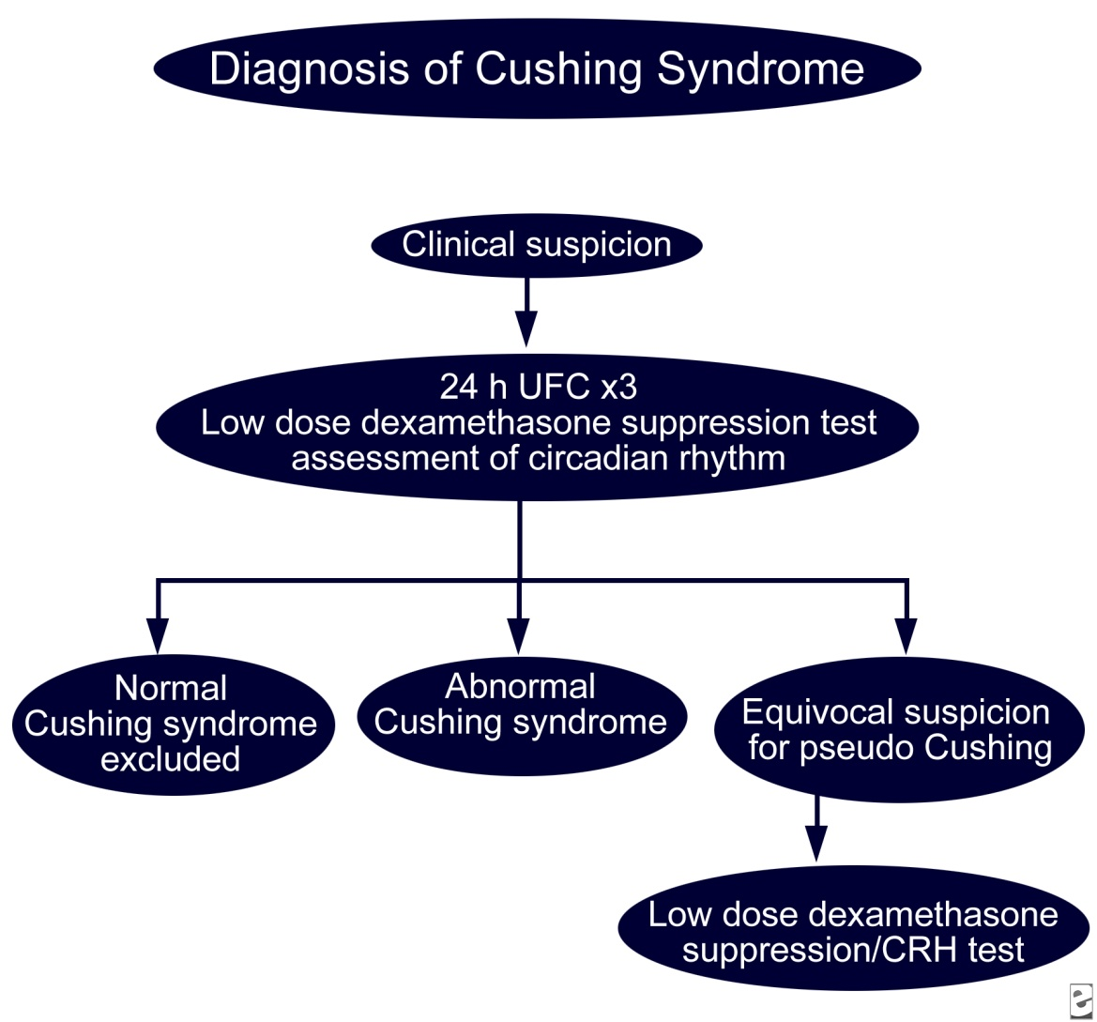
Cushing’s syndrome

Slide 30
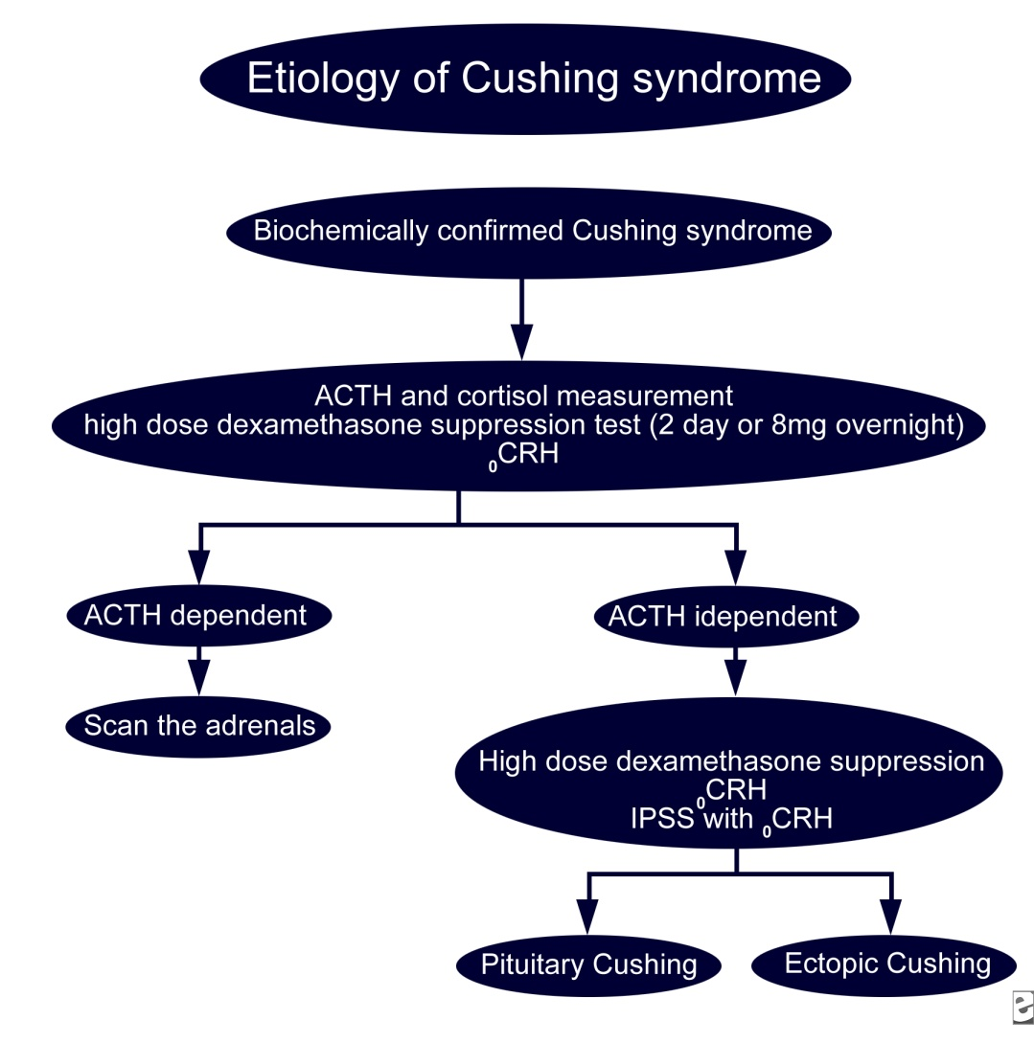
Cushing’s syndrome

Slide 31
Acromegaly
4th decade of life
10.7 years
Constitute 20% of all pituitary tumors
Preop duration 10 years to diagnosis in adults and 3.1 years in children
Pleuri hormonal

Slide 32
ACROMEGALY
Prepuberty-gigantism & precocious puberty
Pubescent-amenorrhea, hypogonadism
Adults-skeletal and soft tissue overgrowth and deformities, cardiac ,neuromuscular, respiratory, endocrine, metabolic complications and neoplastic transformation

Slide 33
Random GH – not useful gives false positive and false negative results
Insulin like growth factor 1 (IGF-1) – best for screening represents average daily GH secretion
Oral glucose GH suppression testing – gold standard to confirm diagnosis :75 mg of glucose load normally suppresses GH > 2ng/ml RIA. GH nadir >2ng/ml RIA with adenoma confirms it
  GHRH stimulation test

Slide 34
ACROMEGALY
Chest and abdomen imaging for ectopic GHRH secreting tumors
Empty sella shows pituitary infarction
Scintigraphy
Ancillary tests
Blood glucose, urine, cardiac and respiratory Screening for colorectal neoplasia

Slide 35
Clinically Acromegaly, MRI pit adenoma, GH>5ng/ml
If GH<5ng/ml
IGF-1, elevated
If no
Oral glucose suppression test confirms it
rarely MRI negative ,
measure GHRH levels, CECT abd /chest

Slide 36
Thyrotroph adenoma
TSH secreting tumors
1-2% of pit adenomas
Mixed hormonal secretion- 30%
GH, PRL, Gonadotropins
90% macroadenomas
Mean duration pt 9 yrs
Clinical features of goitre, warm skin, heat intolerance, cardiac arrhythmias and other hyperthyroid features,

Slide 37
Thyrotroph adenoma
Lab investigations
TSH, Free t4,t3by direct method
a-subunit, PRL, GH, SHB
Iodine scan/USG of thyroid
Dynamic testing with TRH

Slide 38
Clinical suspicion, MRI –pit adenoma, baseline TSH, free T4/T3,a-sub unit,PRL,GH
TSH normal, a-sub unit/TSH ratio
<5.7 in normogonads,<29.1 in hypergonad,
TSH elevated<0.7 in normogonads,
<1.0 in hypergonads
MRI equivocal, TRH stimulation test

Slide 39
Gonadotropinomas
7-15% of pit adenomas
40-50 % macroadenomas secrete gonadotropins
Clinical features of mass effect: visual symptoms, hypogonadism, amennorrhea, hypothyroid, hypocortisolism

Slide 40
Gonadotropinomas
Lab investigations
basal hormonal levels
TRH stimulated gonadotropins, and sub units
normally causes absent FSH response and no more than
33% increase in LH and b- LH
primary hypogonadism LH,FSH elevated and don’t respond
to TRH
gonadotropinomas have greater than 60% increase in b-LH
levels

Slide 41
Multidisciplinary approach
Hormonal status-endocrinologist
Visual field –orthoptist
Monitor tumor recurrence –radiologist
Clinical observation-neurosurgeon
Blood test-biochemist

Slide 42
THANK YOU

